Slide 1

Analysis Considerations
Session 4

Slide 2

Avoid p-Hacking
Notes:
You may have heard of the replication crisis—we now know this to be partly the result of a number of SEEMINGLY INNOCENT but DANGEROUS analytics practices. This has led many a scientific study (even in medicine, oncology research, psychology, etc.) to invalidity.
What are these mistakes, and how can we prevent them?

Slide 3
Remember
p = % of time result occurs by chance
“significant” if p < .05

Slide 4

“p-Hacking”
Systematically “hacking” your data to get p < .05
Adding participants until p < .05
Comparing subgroups until something is p < .05
Trying analysis with/without controls, predictors, etc.
Trying analysis with different estimators / models / transformations
Etc.
Notes:
Why tempting: Easy insights. Big result = good for me

Slide 5
Why It’s Bad?
Sample results are estimates with error
Selecting for big, significant results tends to select for error
Such results replicate / cross-validate poorly

Slide 6
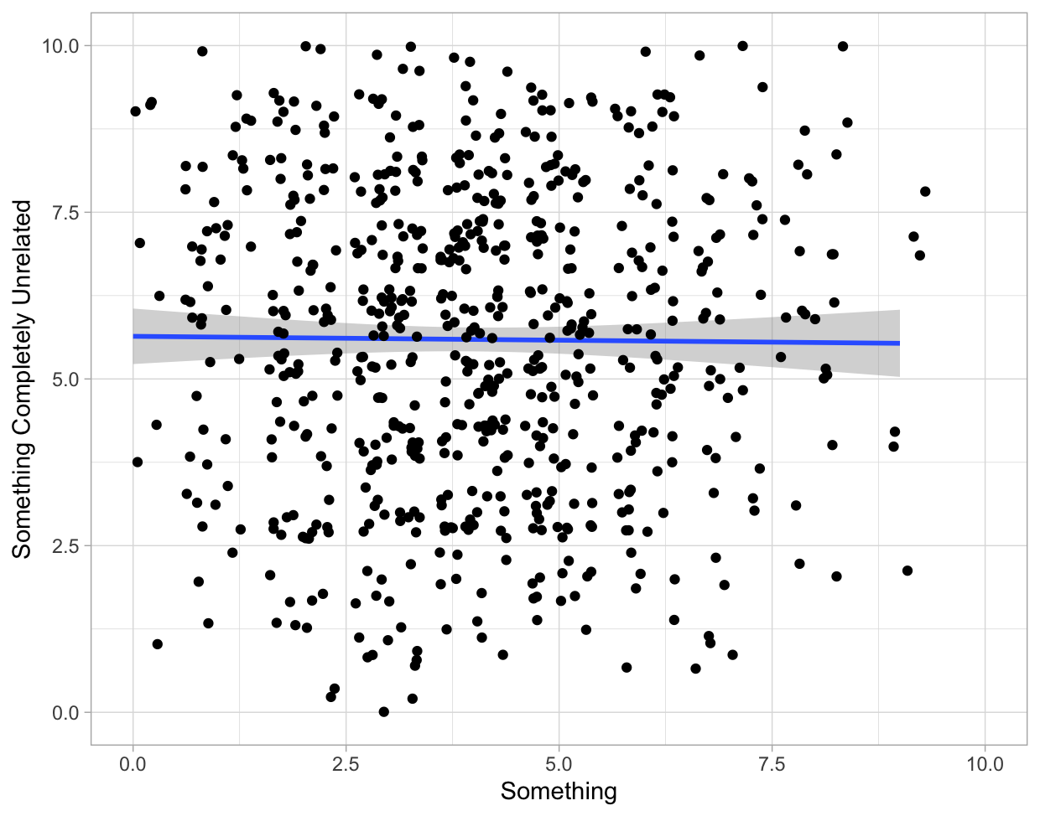
Nothing here

Slide 7
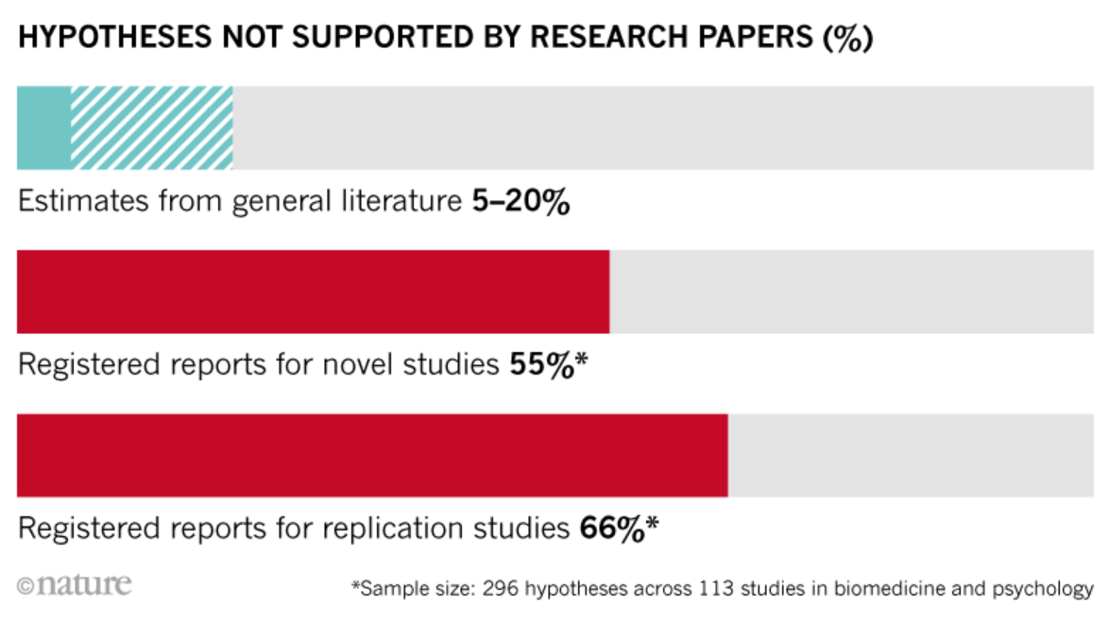
https://www.nature.com/articles/d41586-018-07118-1

Slide 8
https://www.nature.com/articles/d41586-018-07118-1

Slide 9
If you explored the data:
Disclose
Ask
Confirm
How much exploration (rethink reporting?)
Can a case be made against the finding?
Cross-validate in holdout data or replication data
Notes:
Disclose: How much exploration was done (need to rethink reporting?)
Ask: Was there evidence against the conclusion?
Confirm: Test the result with holdout / replication data

Slide 10

Python Exercise

Slide 11
You Need Power

Slide 12
Power
Percentage of time you’ll detect real effects (want 80%+?)
For a given effect size and sample size
Larger effects = more power
Larger sample size = more power
Control via sample size . Big data = good
Notes:
This leads to a problem whereby small effects go undetected. When we filter for only “significant” effects

Slide 13
Caveat
Separate issue from having the right people

Slide 14
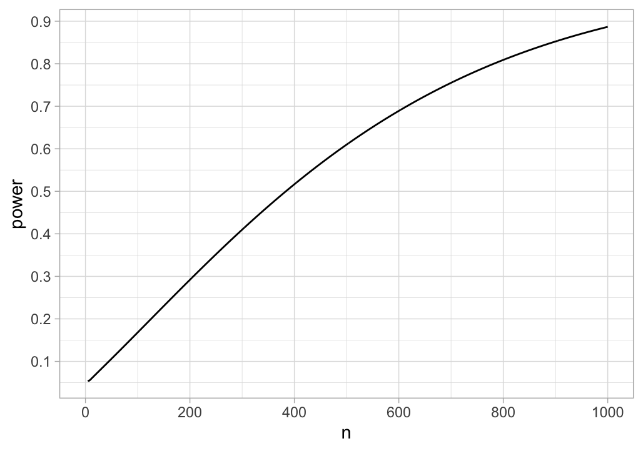
Power to Detect r = .10
Notes:
T-test for correlation, two tailed, alpha = .05

Slide 15
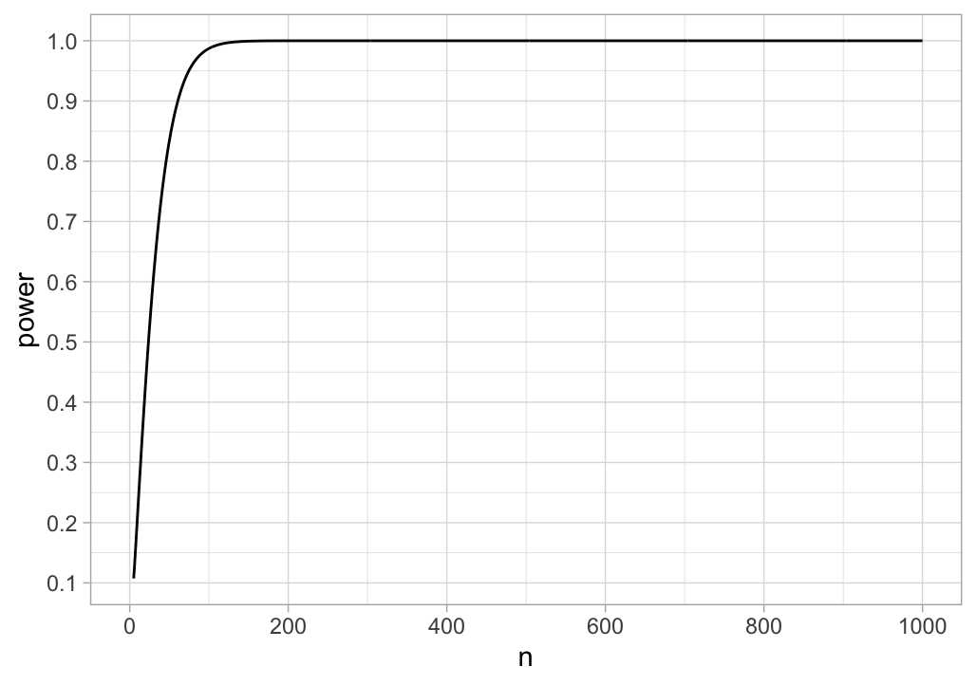
Power to Detect r = .40
Notes:
This leads to a problem whereby small effects go undetected. When we filter for only “significant” effects

Slide 16
If Power is Low
Will miss things (p > .05)
Results not trustworthy
Effect size estimates are imprecise (large CI)

Slide 17
If Power is Low
Will miss things (p > .05)
Results not trustworthy
Effect size estimates are imprecise (large CI)
Always check minimum sample size for SESOI

Slide 18
Python Exercise

Slide 19
A Perfect Storm
Notes:
You may have heard of the replication crisis—we now know this to be partly the result of a number of SEEMINGLY INNOCENT but DANGEROUS analytics practices. This has led many a scientific study (even in medicine, oncology research, psychology, etc.) to invalidity.
What are these mistakes, and how can we prevent them?

Slide 20
Weak power + Weak priors = Few true positives
(poor detection)
(not much there)
(BIG PROBLEM)
Going “fishing”?
Small effects?
Notes:
. Need to cross-validate. Most p-hacked results wont.

Slide 21
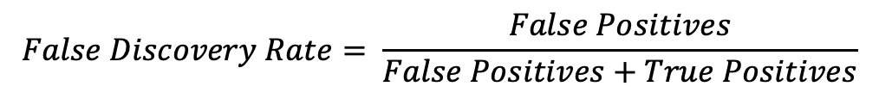
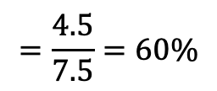
Weak priors: 10% of effects exist
100 Tests
10 Effects Present
90 Effects Absent
Small data (power): only 30% detected
5% false positive rate
Happens often when “fishing” for small effects
3 True Positive Results (p < .05)
4.5 False Positive Results (p < .05)
$$False Discovery Rate= \frac{False Positives}{False Positives+True Positives}$$
$$=\frac{4.5}{7.5}=60\%$$

